Slide 1
A Guide to Creating Your First Custom z/OSMF Plugin —
A Guide to Creating your First Custom z/OSMF Plugin/ © 2025 IBM Corporation

Slide 2
Agenda
z/OSMF Plugins Overview
z/OSMF Plugin Architecture
Backend, Descriptor File, Frontend, Security
Example of a third-party z/OSMF plug-in
Overview
Deploy
Import
A Guide to Creating your First Custom z/OSMF Plugin/ © 2025 IBM Corporation

Slide 3
z/OSMF Plugins Overview
A Guide to Creating your First Custom z/OSMF Plugin/ © 2025 IBM Corporation

Slide 4
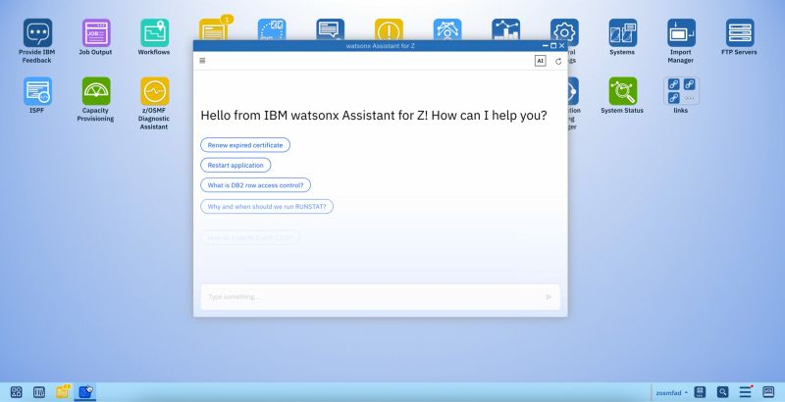
What is a z/OSMF plugin?
It’s an extension to z/OS Management Facility (z/OSMF) that adds new functionality to the web-based interface for managing z/OS
It’s a web application that runs on z/OSMF platform
Has modern user interface - Uses web technologies like IBM Carbon Angular, React
Integrates with z/OS Services – Leverages REST APIs
Launched form the z/OSMF Desktop
A Guide to Creating your First Custom z/OSMF Plugin/ © 2025 IBM Corporation

Slide 5
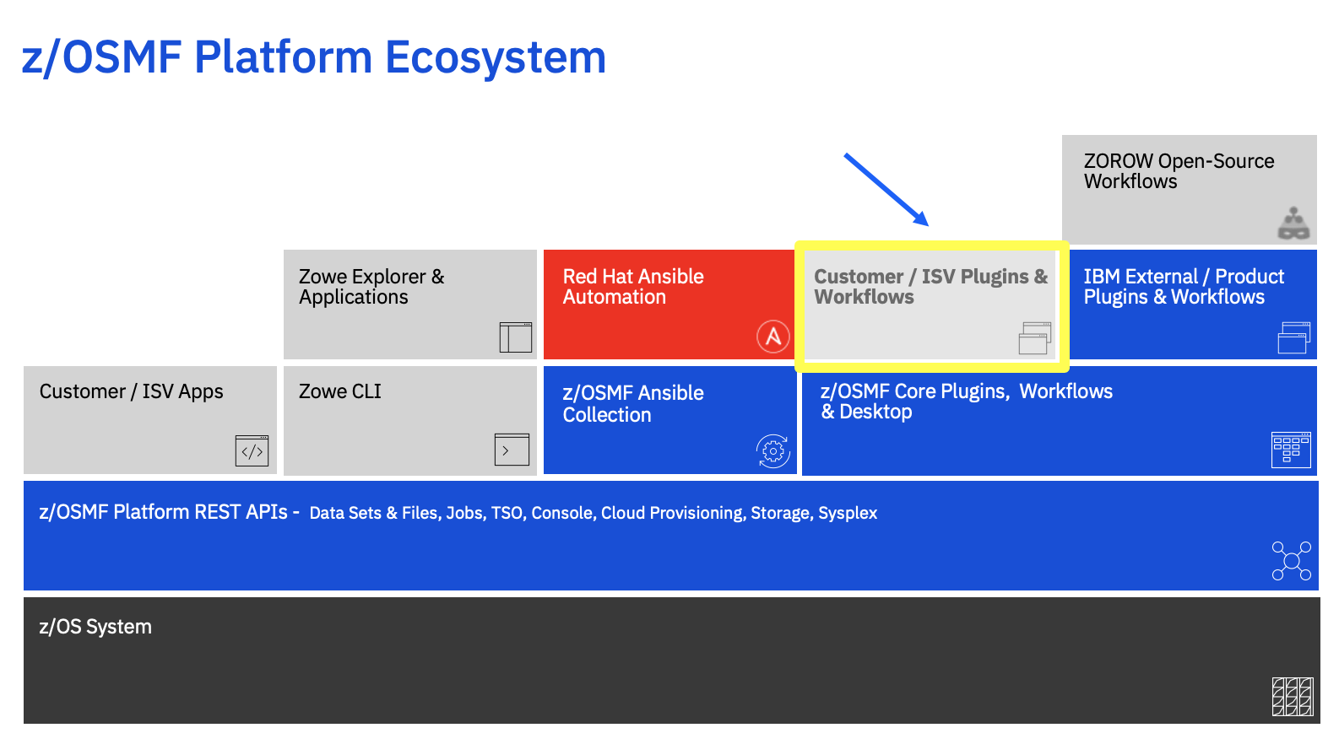
Where do external plugins fit into z/OSMF ecosystem?
Different types of z/OSMF plugins
Core / Optional Plugins: Part of z/OS and Built by IBM
External Plugins
IBM Product Plugins : Usually, part of priced products such as zSecure Admin
Customer & ISV Plugins: Anyone can build them Broadcom, 21CS, Rocket, you
A Guide to Creating your First Custom z/OSMF Plugin/ © 2025 IBM Corporation

Slide 6
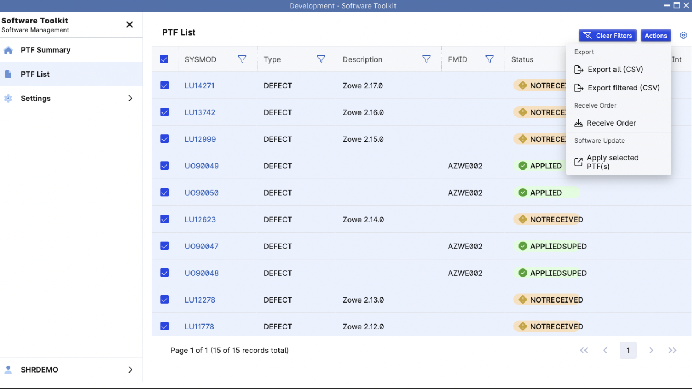
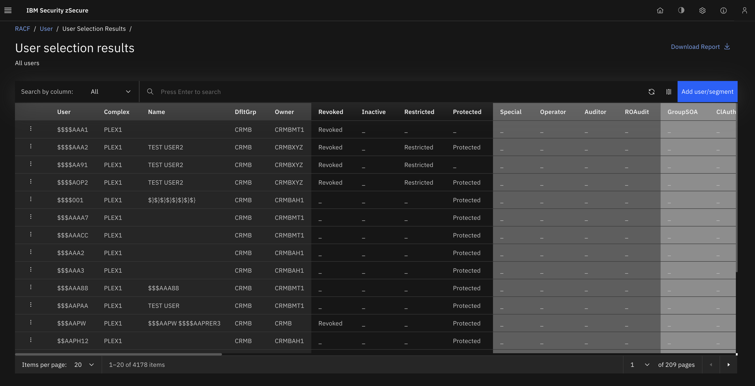
z/OSMF Plugins come in all shapes and sizes
z/OSMF plugins are highly versatile, supporting a wide range of use cases
Single page plugins (Diagnostic Assistant) to plugins consisting of hundreds of screens and dialogs (Software Management)
Can have any look and feel
Takeaway: No matter the complexity, scale, or use case, z/OSMF plugins adapt to your needs—from small utilities to enterprise-wide applications
Broadcom Software Toolkit
zSecure Dark Theme
A Guide to Creating your First Custom z/OSMF Plugin/ © 2025 IBM Corporation

Slide 7
Why use IBM Carbon?
IBM Carbon is an open-source design system that provides reusable UI components, guidelines, and frameworks for building consistent applications
Multiple JavaScript frameworks supported (Angular, React)
Common look and feel with newest IBM z/OSMF Plugins
Carbon Website: https://carbondesignsystem.com/
5. Carbon UI Builder: https://builder.carbondesignsystem.com/
A Guide to Creating your First Custom z/OSMF Plugin/ © 2025 IBM Corporation

Slide 8
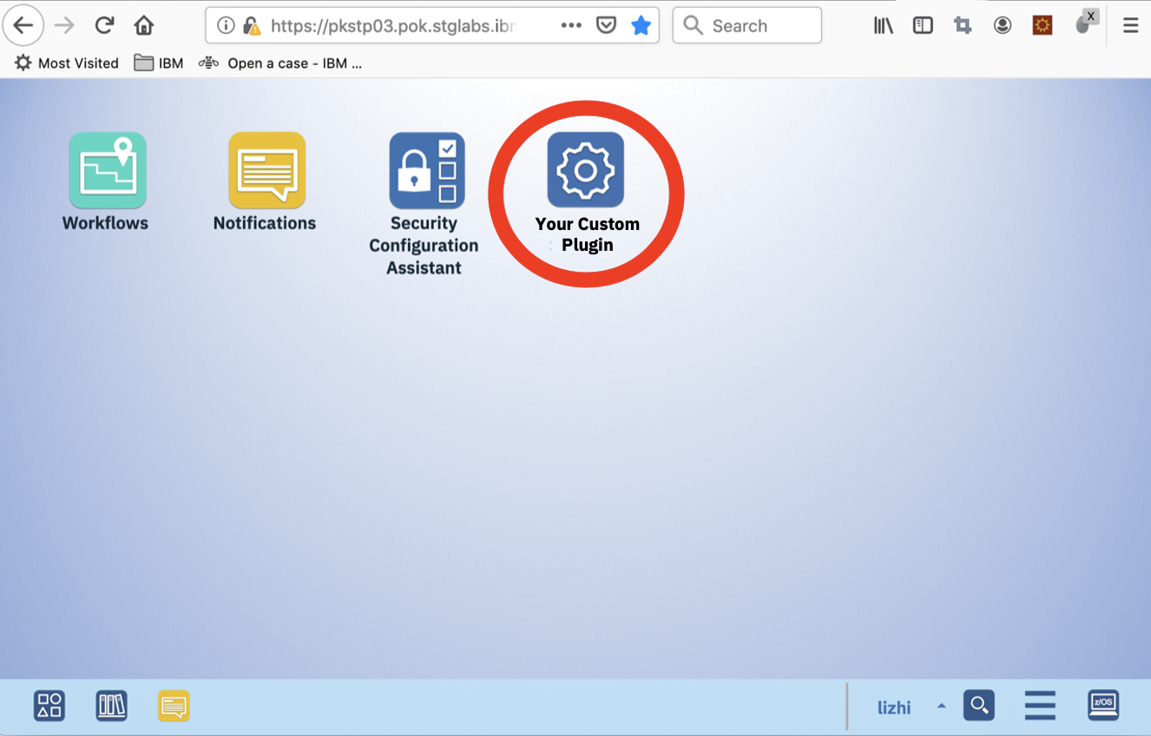
Why build a z/OSMF plugin?
Leverage z/OSMF’s built-in platform capabilities (webserver, security, logging, APIs, etc.)
Integrate directly into the z/OS simplification platform
Flexibility to support any use case
Port custom green screen-based applications
Small utilities (IPL prep checklist, Connectivity test)
Any idea that you have
A Guide to Creating your First Custom z/OSMF Plugin/ © 2025 IBM Corporation

Slide 9
z/OSMF External Plugin Architecture
A Guide to Creating your First Custom z/OSMF Plugin/ © 2025 IBM Corporation

Slide 10
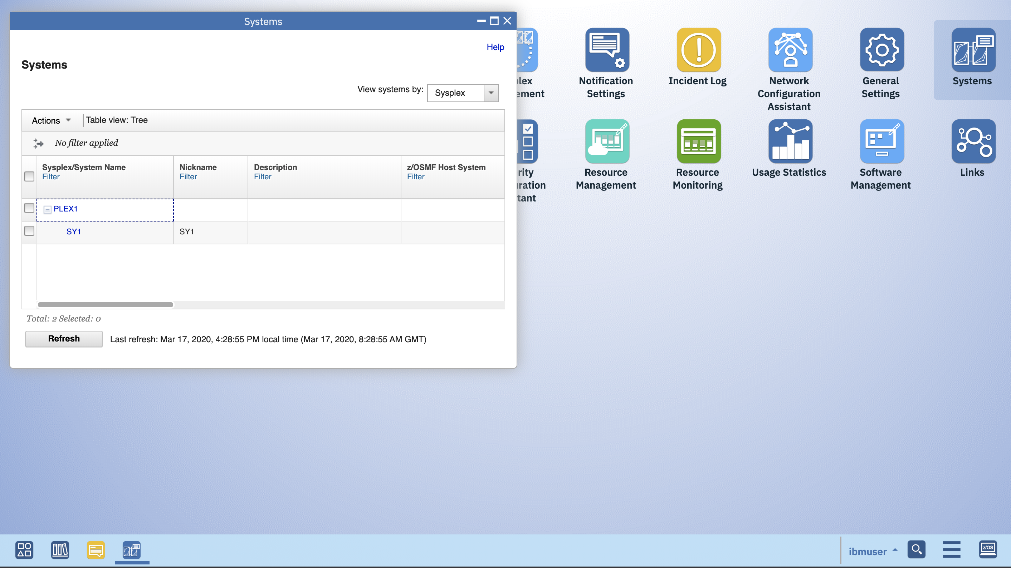
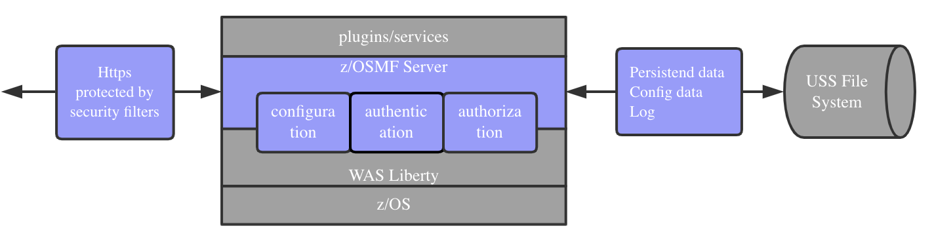
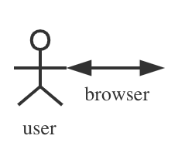

z/OSMF External Plugin Architecture Overview
Web application “external” to z/OSMF product, delivered by IBM or third-party software provider and integrated in z/OSMF UI and drives interaction with
z/OSMF REST APIs or
REST APIs provided by IBM or third-party Webserver
Browser
z/OSMF Server
Https
IBM or Third-Party WebServer
A Guide to Creating your First Custom z/OSMF Plugin/ © 2025 IBM Corporation

Slide 11
Building z/OSMF External Plugin
A Guide to Creating your First Custom z/OSMF Plugin/ © 2025 IBM Corporation

Slide 12
Pre-requisites for a z/OSMF plugin
Skills
JavaScript - For front-end development (e.g., Angular, React-based UI with IBM Carbon Design)
HTML & CSS - To design and style the UI
z/OSMF REST APIs - Understanding API calls to interact with z/OS services
Tools
VS Code Editor – Primary development environment for writing and debugging code
Node.js
NPM (Node Package Manager) - is a tool for managing JavaScript package
A Guide to Creating your First Custom z/OSMF Plugin/ © 2025 IBM Corporation

Slide 13
Pre-requisites for building z/OSMF External Plugin
Invoke following command to check if node.js is installed on your system
node –v
nvm current
Suggested Node version should be at V18 or higher.
Install Node.js if it’s not installed. Follow instruction described at following website
https://nodejs.org/en/download
Use nvm command to verify node is properly installed on system
nvm current -> Should show V18 or higher
A Guide to Creating your First Custom z/OSMF Plugin/ © 2025 IBM Corporation

Slide 14
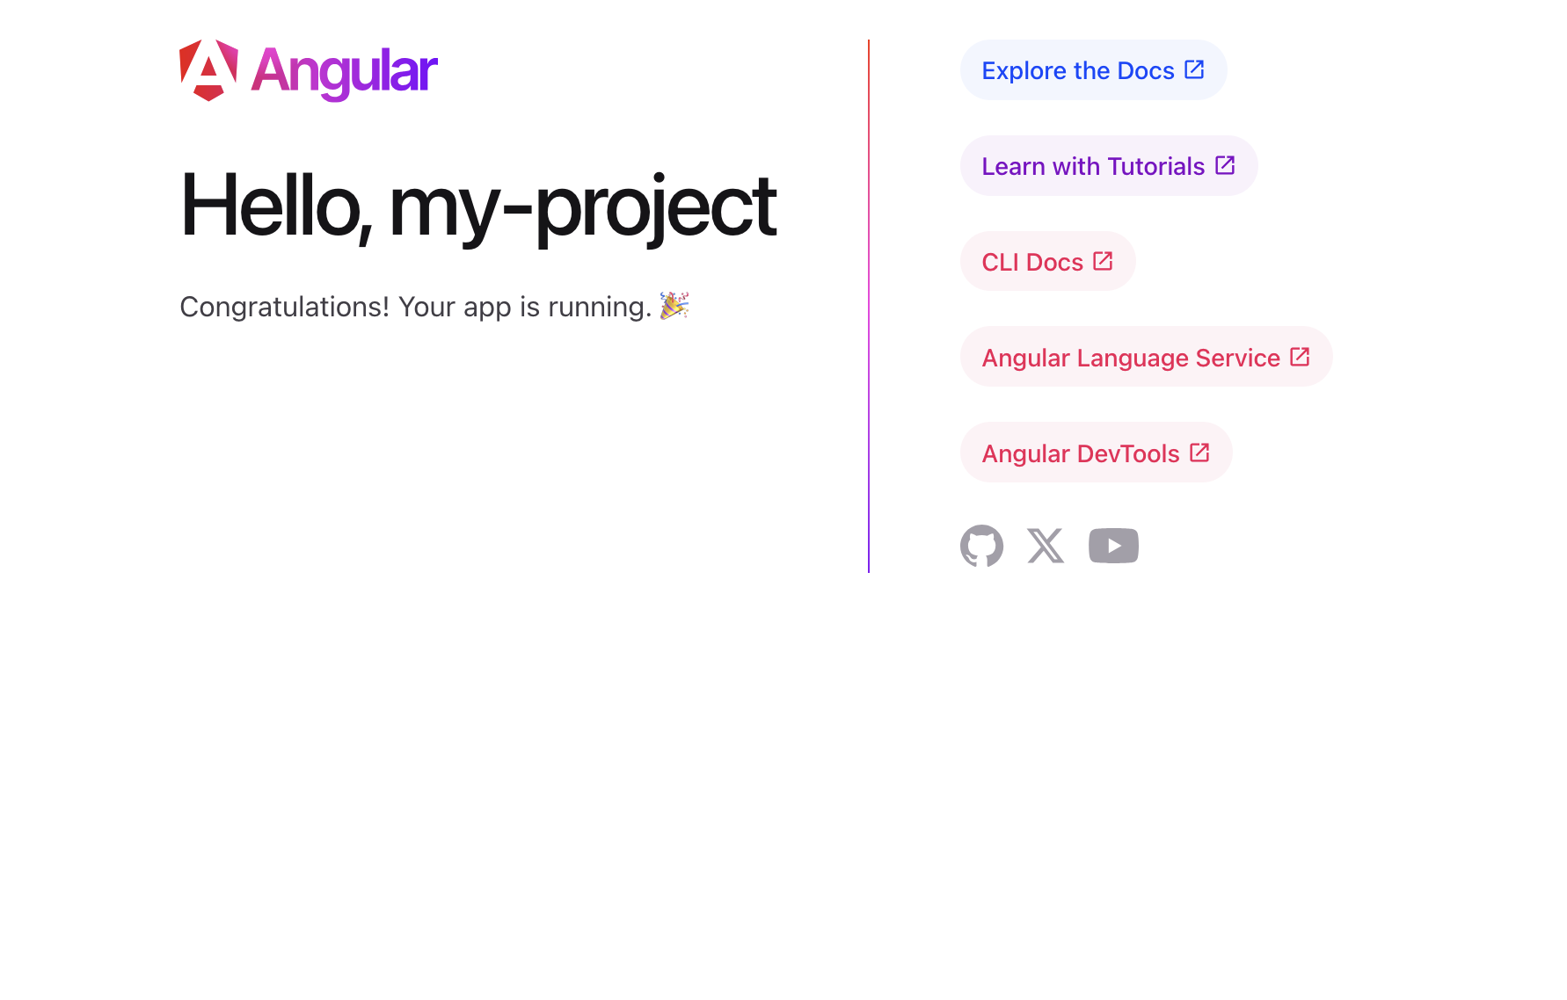
Primer - Sample Angular application
Follow instruction provided at following git repo to create your first angular application.
https://github.com/carbon-design-system/carbon-components-angular?tab=readme-ov-file
Following commands will create your first Angular application.
mkdir AngShareSample
cd AngShareSample
npx @angular/cli new my-project --style=scss
cd my-project
npm i --save carbon-components-angular @carbon/styles
npm start
A Guide to Creating your First Custom z/OSMF Plugin/ © 2025 IBM Corporation

Slide 15
Main building blocks for Angular application
Module
Modules are like containers for components, directives, services, etc. They help to organize an Angular application which makes it easier to manage or scale application. The root module also known as App Module provides a starting point for the application.
Component
Components are the fundamental block for the Angular application interface. They combine the presentation layer (template) and component class.
Template
Templates define the structure of components using Angular templating syntax. They display the data and provide the structure for the user interface.
Style
For every Angular component along with HTML template, CSS styles goes with that template, specifying any selectors, rules, and media queries that web application need
Service
Services refer to those classes that provide functionality. They are designed to be embedded into components, services, or modules that assist in handling communication with API.
A Guide to Creating your First Custom z/OSMF Plugin/ © 2025 IBM Corporation

Slide 16
Steps to build z/OSMF External Plugin
Develop a web-based application and the supporting documentation for the functions you want to add to z/﻿OSMF as external plugin
Build the application and start locally to make sure there is no issue
npm run build
npm start
Store the application and its documentation in the UNIX file system. Set 644 permissions for files and 755 permissions for folders.
Create a property file in the UNIX file system that defines the parameters required for z/﻿OSMF to import and configure your plug-in.
Use the z/﻿OSMF Import Manager task to import the property file.
Set up security for your plug-in. After which, you must refresh the security management product on your system and restart the z/﻿OSMF server to have your changes take affect.
Run plugin from z/OSMF UI
A Guide to Creating your First Custom z/OSMF Plugin/ © 2025 IBM Corporation

Slide 17
Sample z/OSMF External Plugin
A Guide to Creating your First Custom z/OSMF Plugin/ © 2025 IBM Corporation

Slide 18
Sample z/OSMF External Plugin
Asks user to specify PROC to be used to establish TSO session
Establishes TSO session using z/OSMF TSO REST API
Invokes long running REXX exec via z/OSMF TSO REST API
Asks user to select a variable to obtain value
Passes the user input to REXX EXEC and invokes MVSVAR to obtain value.
Shows system information associated with selected variable
User stops TSO session
User exits the app and appropriate clean up is performed
A Guide to Creating your First Custom z/OSMF Plugin/ © 2025 IBM Corporation

Slide 19
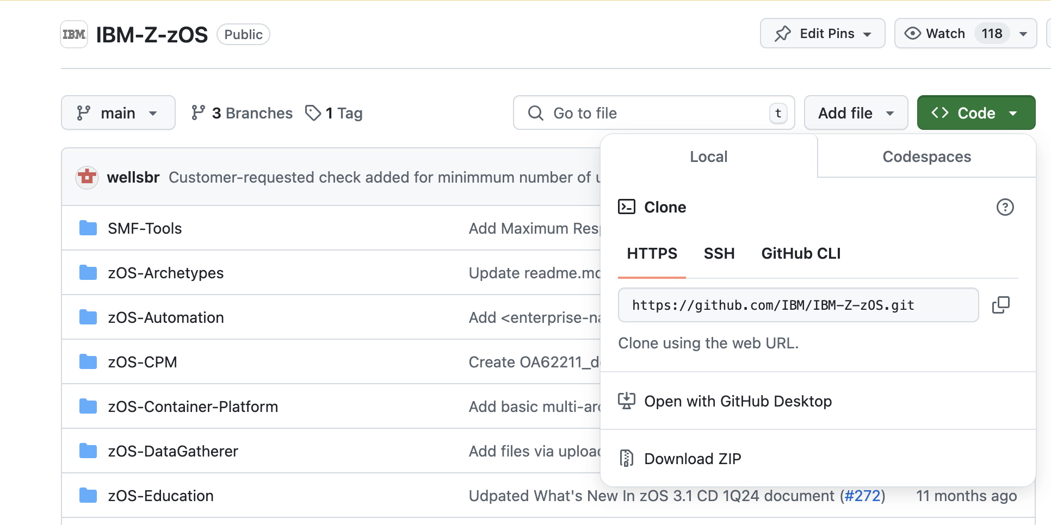
Sample z/OSMF External Plugin
Download external plugin from git
https://github.com/IBM/IBM-Z-zOS/
Download the zip file and unzip it
A Guide to Creating your First Custom z/OSMF Plugin/ © 2025 IBM Corporation

Slide 20
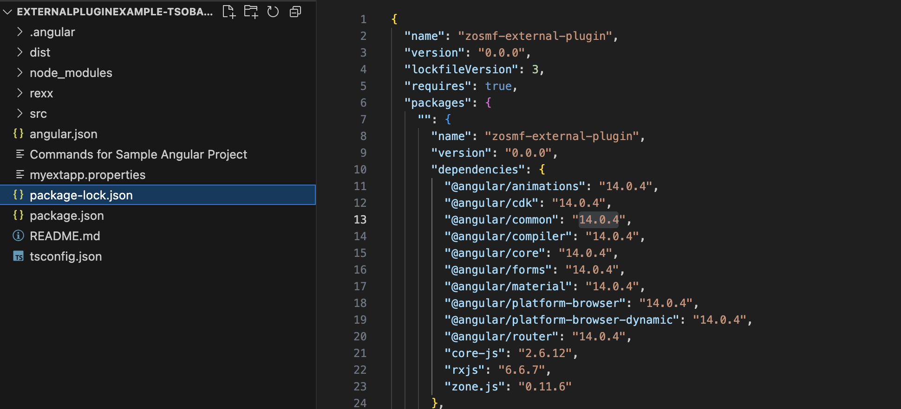
Sample z/OSMF External Plugin
Currently there is a dependency on Angular 14, so following clean up is required after download:
Remove package-lock.json
rm -rf package-lock.json
Force install the dependency
npm i –force
Angular components are now installed in current project under “node_modules”
A Guide to Creating your First Custom z/OSMF Plugin/ © 2025 IBM Corporation

Slide 21
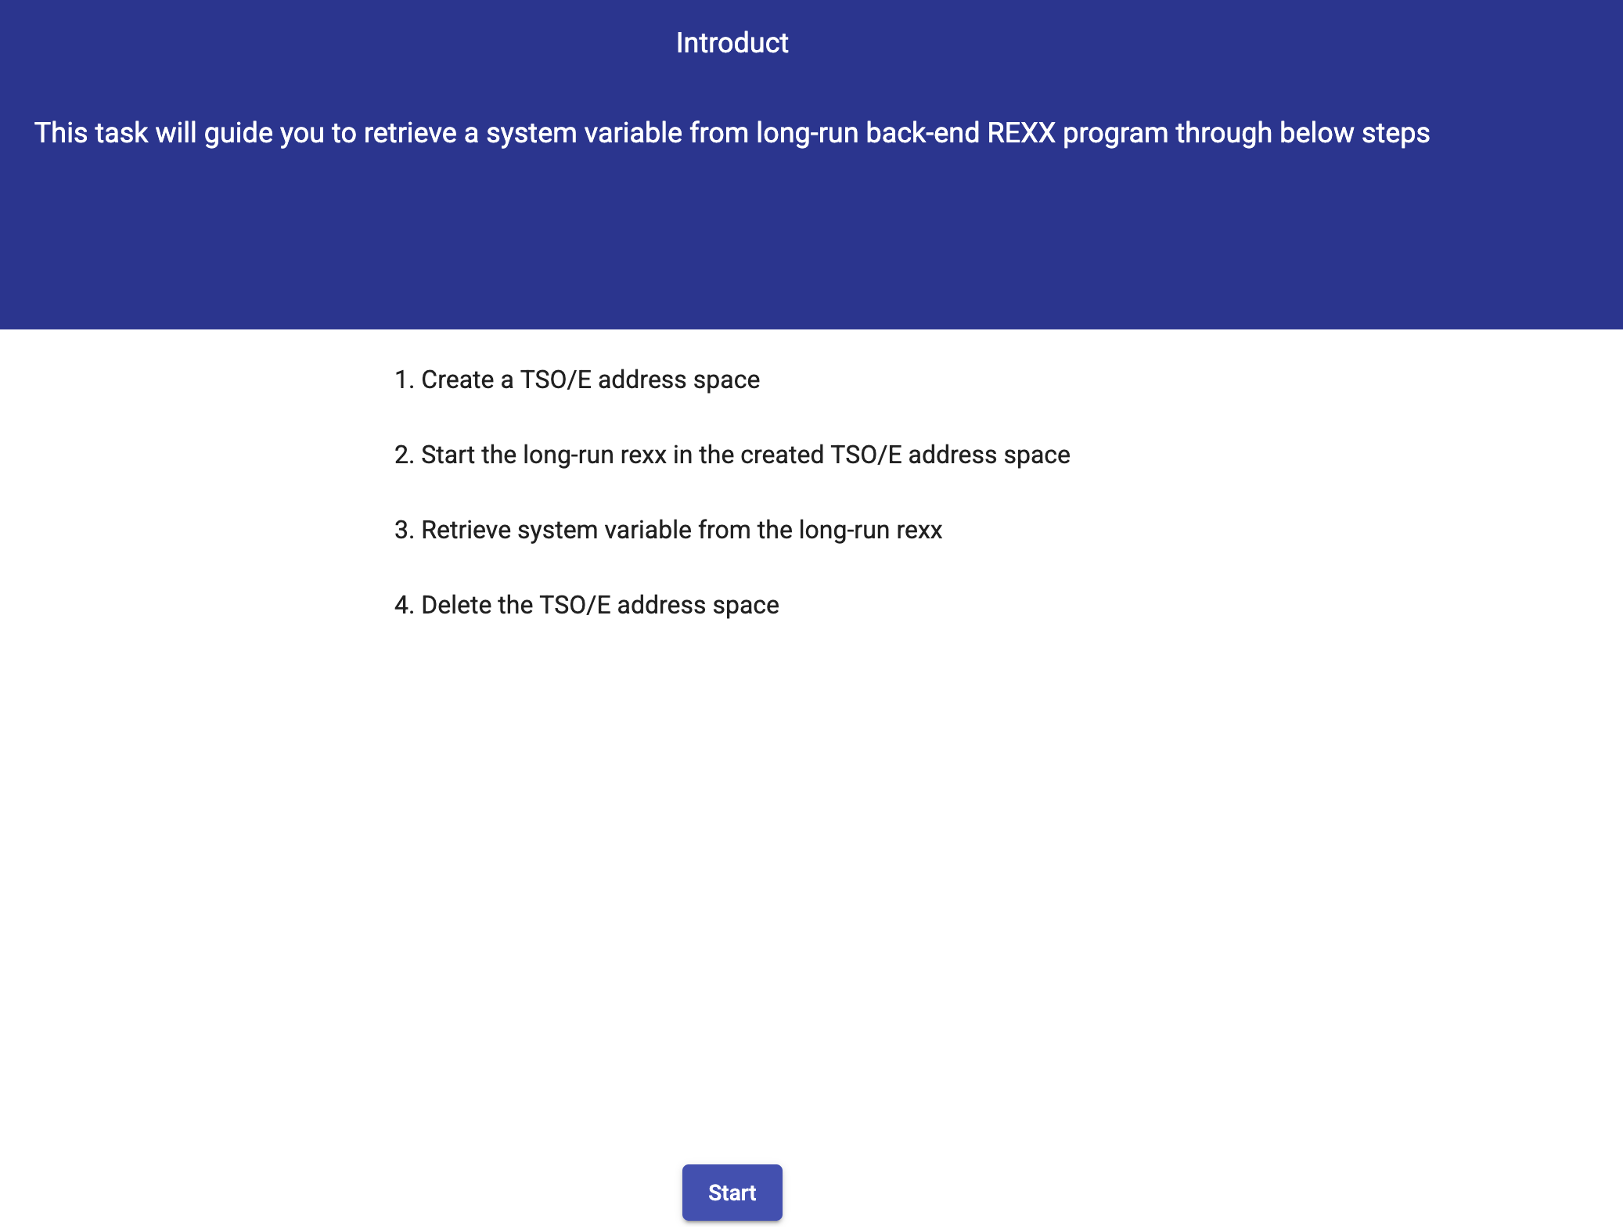
Sample z/OSMF External Plugin
Make sure sample application can be built and started
npm start
A Guide to Creating your First Custom z/OSMF Plugin/ © 2025 IBM Corporation

Slide 22
Building blocks used in Sample z/OSMF Plugin
Module – app.module.ts
Template, Style-Sheet, Component - /src/app/var-viewer/ This directory contains the component VarViewerComponent. This component is used for displaying data, handling user interaction, and calling services for communicating with z/OSMF.
Services - /src/app/service/ This directory contains
tso.service.ts This program uses REST APIs to work with a subordinate TSO/E address space. Specifically, the TsoService program creates a TSO/E address space, starts an application in the TSO/E address space, and retrieves messages from the application. It will be injected into VarViewerComponent as an instance at the beginning.
persist.service.ts This program uses z/OSMF REST APIs to exchange persistent data with the z/OSMF server.
log.service.ts This program writes messages to the z/OSMF server log files.
Tools - /src/app/tool/zosmfTools.ts This program overrides the cleanupBeforeDestroy method that is normally used by the z/OSMF desktop whenever a user closes the plug-in window.
A Guide to Creating your First Custom z/OSMF Plugin/ © 2025 IBM Corporation

Slide 23
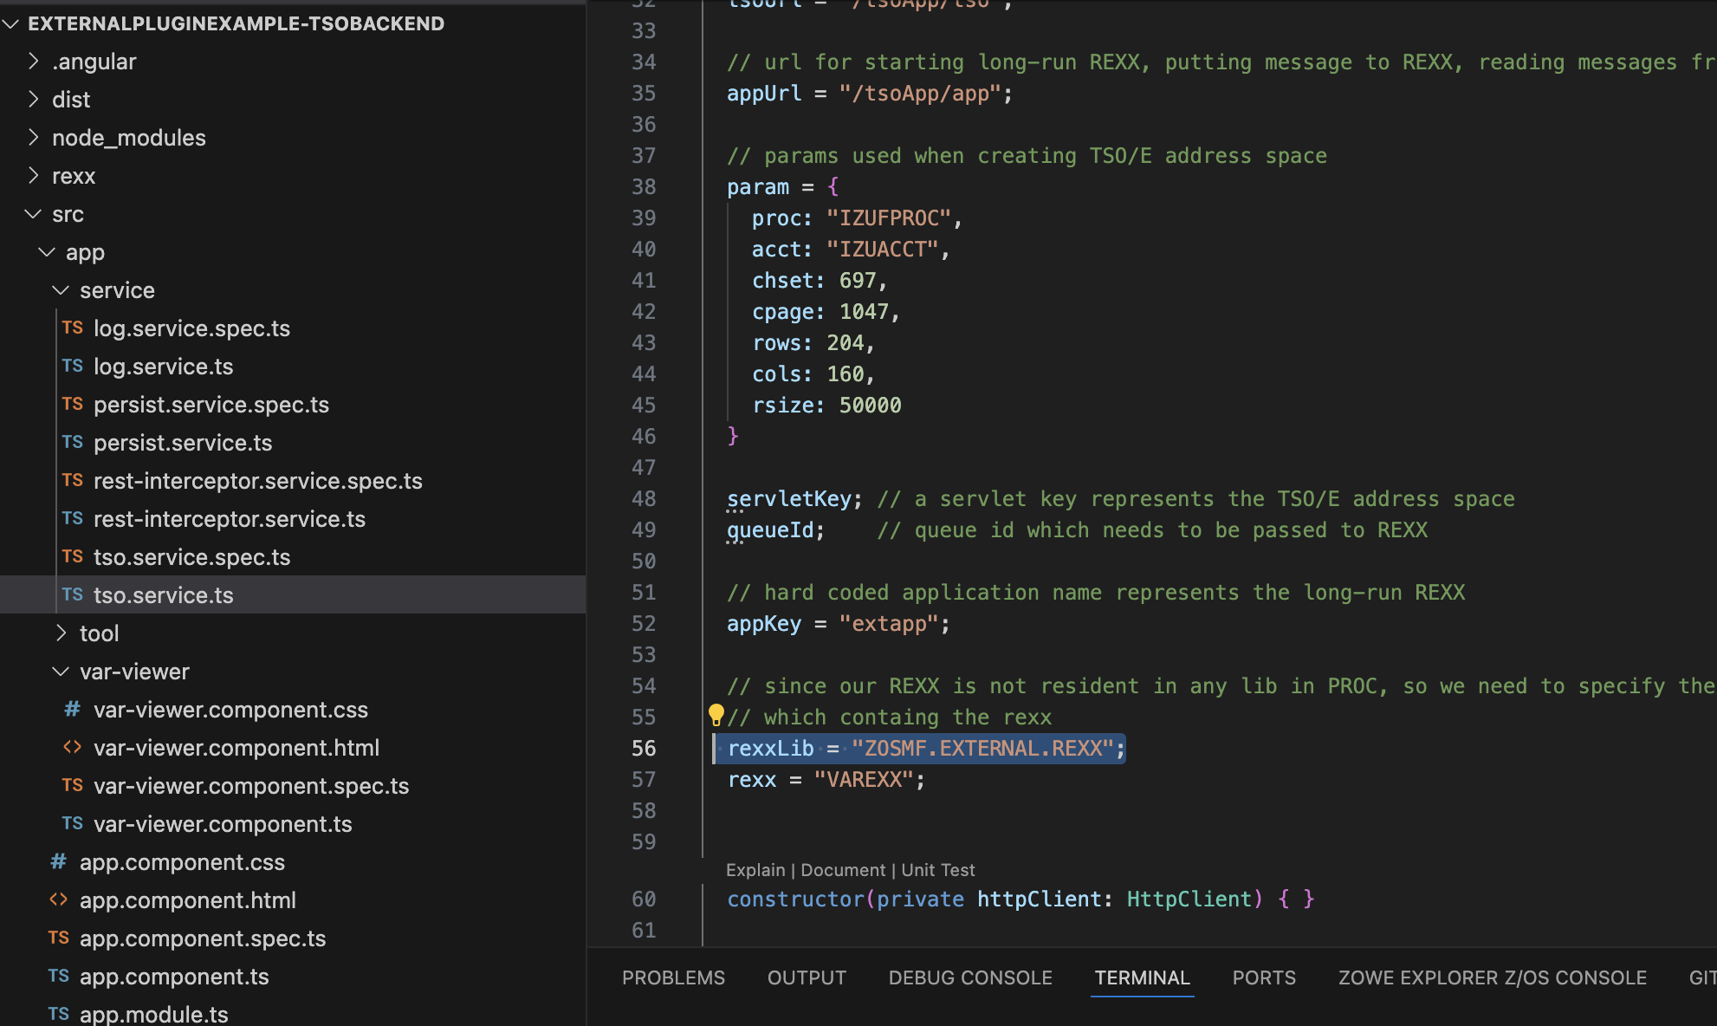
Update Sample z/OSMF External Plugin
Change application to identify which dataset REXX exec will be saved in
In this example it was saved in ZOSMF.EXTERNAL.REXX dataset
Build application
npm run build
Verify application starts locally outside of z/OSMF
npm start
Upload compiled web application to z/OS
Upload content of /dist/zosmf-external-plugin/ in binary
Remember to set file permission to 644
A Guide to Creating your First Custom z/OSMF Plugin/ © 2025 IBM Corporation

Slide 24
Run Sample z/OSMF External Plugin
Complete the remaining steps and run the sample plugin
Import external plugin into z/OSMF using Import Manager
Set up security resource using Security Configuration Assistant
Run the plugin
Make simple change to web application
Build web application
Upload changes to z/OS
Run the plugin to show modified user interface
A Guide to Creating your First Custom z/OSMF Plugin/ © 2025 IBM Corporation

Slide 25
Additional Resources:
Creating your own z/OSMF plug-in Documentation
https://www.ibm.com/docs/en/zos/3.1.0?topic=guide-creating-your-own-zosmf-plug-ins
z/OSMF external plug-in sample/ Github
https://github.com/IBM/IBM-Z-zOS/blob/main/zOSMF/ExternalPluginExample-TSOBackend/README.md#zosmfexternalplugin
A Guide to Creating your First Custom z/OSMF Plugin/ © 2025 IBM Corporation

